Slide 1
Amazon
Reviews
Summarizer
Team Members: M. Dheeraj - 2101AI18
R. Vivek - 2101CS65
R. Eshwar - 2101AI25

Slide 2
Problem Statement
Identify whether a product is useful in India based on user reviews.
Collect 500 reviews from Indian users for each of 50 products and
annotate usefulness.
Analyze sentiment and mine product aspects (likes/dislikes).
Summarize user opinions and train a classifier.

Slide 3
Dataset Details
A review scraper using selenium and beautifulsoup to get reviews with features product_id , user_name , review_rating , review_title , review_description and save them to data.csv
Dataset size : 25000 (50 * 500 ) ( Products * Reviews per product)

Slide 4
Annotation
Performed Sentiment Analysis using:
TextBlob – Lexicon-based polarity , VADER – Rule-based compound score
BERT – Transformer-based sentiment , Rating (scaled)
Final Sentiment Score = Average of all methods
Products labeled as:
"Useful" if average score > 0.705
"Not Useful" otherwise

Slide 5
Reviews Analysis
Sentiment Analysis:
Classified reviews as Positive, Negative, or Neutral using VADER.
Overall Verdict: Products labeled Liked if positive reviews > negative, else Not Liked.
Aspect-Based Opinion Mining:
Used spaCy to extract key product aspects (e.g., battery, camera).
Counted sentiment mentions for each aspect.
Listed top appreciated and criticized aspects for each product.

Slide 6
Methodology (1)
Data Preprocessing:
Merged datasets and engineered features (e.g., average ratings, sentiment scores).
Created target variable: "Useful" vs "Not Useful."
EDA:
Visualized Verdict Distribution, Correlation Heatmap, Sentiment Score Distribution, and Review Length Distribution.

Slide 7
Methodology (2)
Modeling:
Trained Random Forest classifier.
Preprocessed data using TF-IDF for text and StandardScaler for numeric features.
Evaluation:
Assessed performance with metrics (Accuracy, Precision, Recall, F1-Score.

Slide 8
Results
Annotation :
Useful 41
Not Useful 9
Sentiment Analysis and Aspect-based opinion mining :
Generated two csv files to report the findings
Product_overall_sentiment_summary.csv includes the following columns:
product_id, total_reviews, positive_reviews, negative_reviews, neutral_reviews, overall_verdict, top_appreciated_aspects, top_criticized_aspects.
Aspect_based_opinion_per_product.csv Includes the following columns:
product_id, aspect, positive_mentions, negative_mentions, net_sentiment.

Slide 9
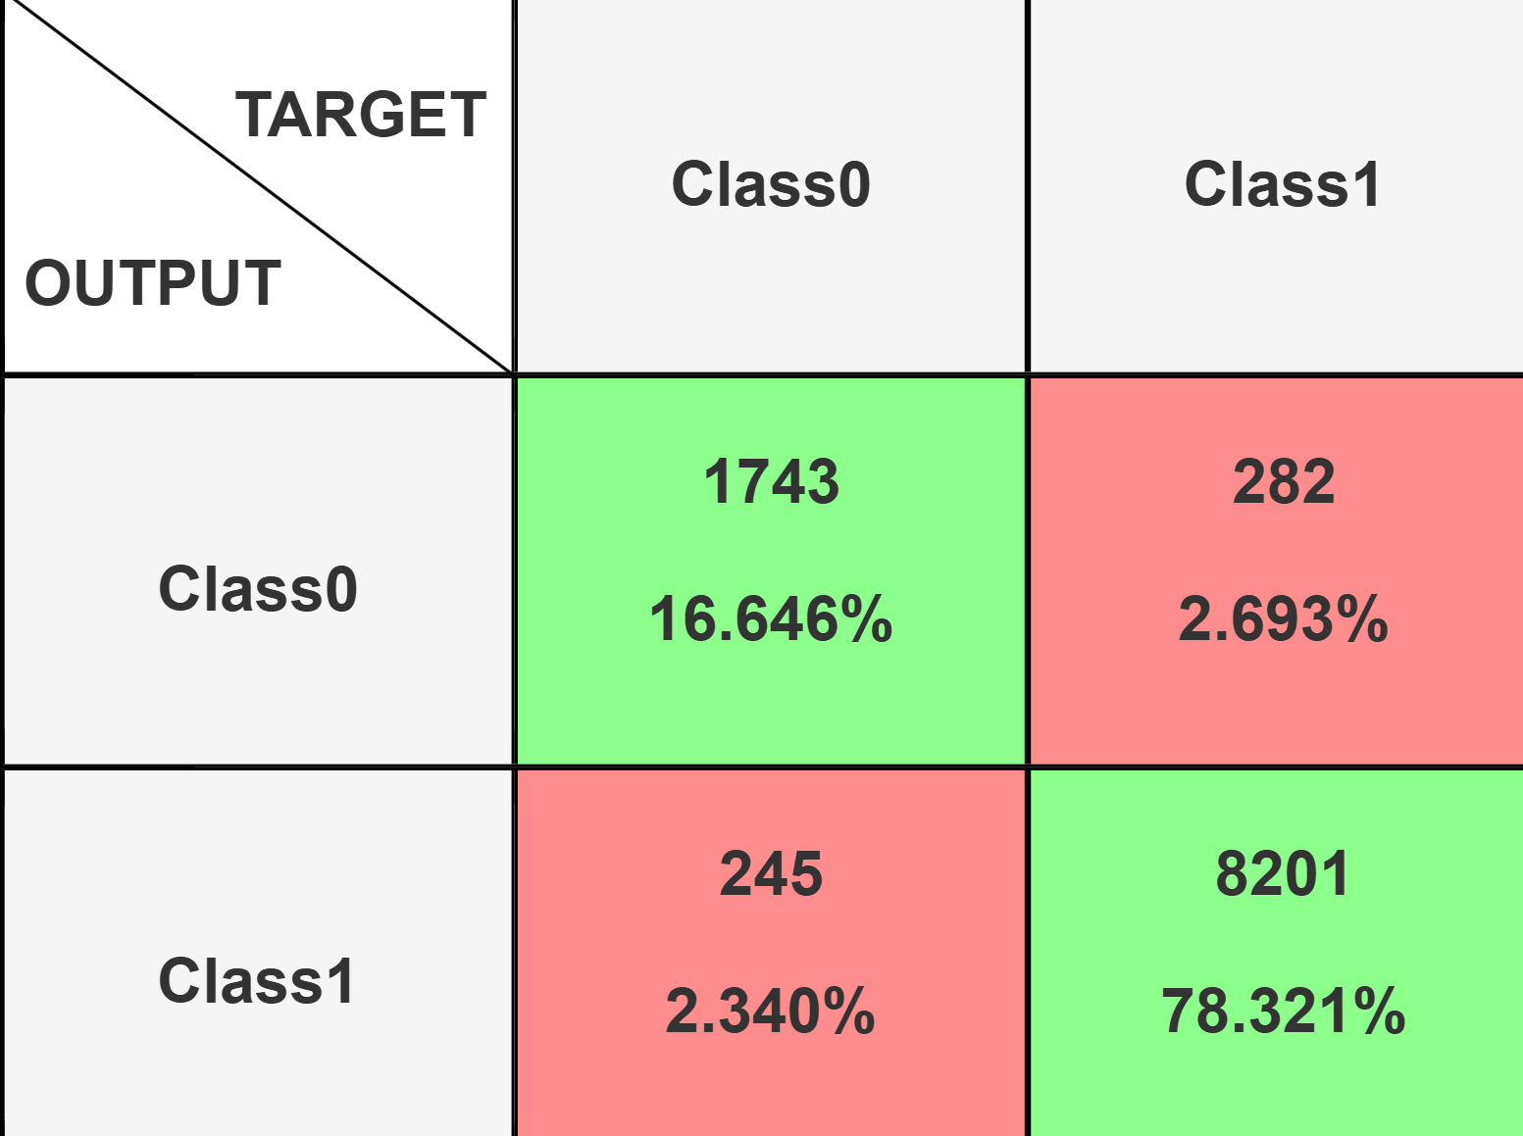
Results (2)
Model | Accuracy | Precision (Useful) | Recall (Useful) | F1-score (Useful)
Random Forest | 0.9497 | 0.9710 | 0.9668 | 0.9689

Slide 10
Conclusion
Future Work Scope :
Gather more diverse data from a wider range of products, which will help improve the generalizability of the model.
Enhance the aspect extraction process to cover more detailed aspects.
Use model’s output in recommender systems for Indian zone as a feature.
Contributions :
R.Eshwar (2101AI25) - Review Scraping , Automated annotations.
M.Dheeraj (2101AI18) - Sentimental Analysis and Aspect-based opinion mining.
R.Vivek (2101CS65) - Train Classifier based on dataset and extracted features.
https://github.com/eshwar0210/CS563-NLP

Slide 11


Thank you!
Team Members: M. Dheeraj - 2101AI18
R. Vivek - 2101CS65
R. Eshwar - 2101AI25

